Slide 1
Electrical
and Electronics science
First year
Computer Science and Engineering
Dr. Shakti Singh
ASSISTANT PROFESSOR
ELECTRCIAL AND INSTRUMENATION
ENGINEERING DEPARTMENT
@shakti.singh@thapar.edu

Slide 2
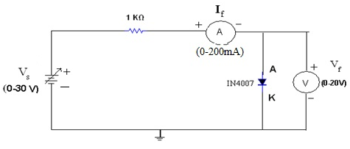
Static V-I Characteristics of a Junction Diode

Slide 3
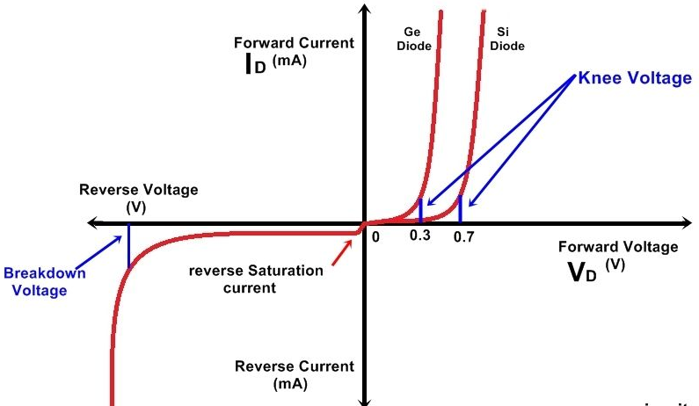
Static V-I Characteristics of a Junction Diode
The Diode Transconductance Curve
V_{D} = Bias Voltage
I_{D} = Current through Diode. I_{D} is Negative for Reverse Bias and Positive for Forward Bias
I_{S} = Saturation Current
V_{BR} = Breakdown Voltage
V_{φ} = Barrier Potential Voltage

Slide 4
Properties of Diodes
The Shockley Equation
The transconductance curve on the previous slide is characterized by the following equation:
I_{D} = I_{S}(e^{VD/ηVT} – 1)
As described in the last slide, I_{D} is the current through the diode, I_{S} is the saturation current and V_{D} is the applied biasing voltage.
V_{T} is the thermal equivalent voltage and is approximately 26 mV at room temperature. The equation to find V_{T} at various temperatures is:
V_{T} = kT
q
k = 1.38 x 10⁻²³ J/K T = temperature in Kelvin q = 1.6 x 10⁻¹⁹ C
η is the emission coefficient for the diode. It is determined by the way the diode is constructed. It somewhat varies with diode current. For a silicon diode η is around 2 for low currents and goes down to about 1 at higher currents

Slide 5
Ideal Diode Characteristics
In an ideal diode, current flow freely through the device when forward biased, having no resistance.
In an ideal diode, there would be no voltage drop across it when forward biased. All of the source voltage would be dropped across circuit resistors.
In an ideal diode, when reverse biased, it would have infinite resistance, causing zero current flow.

Slide 6
Practical Diode Characteristics
A practical diode does offer some resistance to current flow when forward biased.
Since there is some resistance, there will be some power dissipated when current flows through a forward biased diode. Therefore, there is a practical limit to the amount of current a diode can conduct without damage.
A reverse biased diode has very high resistance.
Excessive reverse bias can cause the diode to conduct.

Slide 7
Diode Circuit Models
The Ideal Diode Model
The diode is designed to allow current to flow in only one direction. The perfect diode would be a perfect conductor in one direction (forward bias) and a perfect insulator in the other direction (reverse bias). In many situations, using the ideal diode approximation is acceptable.
Example: Assume the diode in the circuit below is ideal. Determine the value of I_{D} if a) V_{A} = 5 volts (forward bias) and b) V_{A} = -5 volts (reverse bias)
R_{S} = 50 Ω
a) With V_{A} > 0 the diode is in forward bias and is acting like a perfect conductor so:
I_{D} = V_{A}/R_{S} = 5 V / 50 Ω = 100 mA
b) With V_{A} < 0 the diode is in reverse bias and is acting like a perfect insulator, therefore no current can flow and I_{D} = 0.
I_{D}
+
V_{A}
_

Slide 8
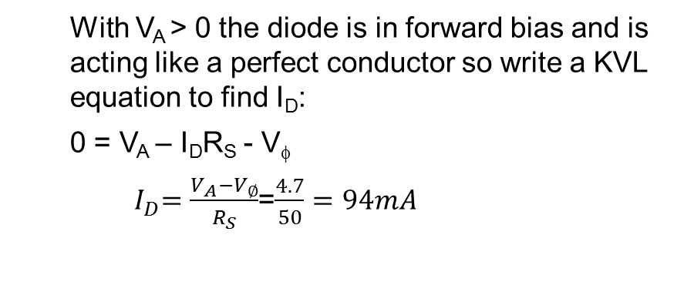
Diode Circuit Models
The Ideal Diode with Barrier Potential
This model is more accurate than the simple ideal diode model because it includes the approximate barrier potential voltage. Remember the barrier potential voltage is the voltage at which appreciable current starts to flow.
+
V_{φ}
Example: To be more accurate than just using the ideal diode model include the barrier potential. Assume V_{φ} = 0.3 volts (typical for a germanium diode) Determine the value of I_{D} if V_{A} = 5 volts (forward bias).
R_{S} = 50 Ω
With V_{A} > 0 the diode is in forward bias and is acting like a perfect conductor so write a KVL equation to find I_{D}:
0 = V_{A} – I_{D}R_{S} - V_{φ}
${ I}_{D}=\frac{V_{A}−V_{∅}}{R_{S}}$=$\frac{4.7}{50}=94mA$
I_{D}
+
V_{A}
_
+
V_{φ}

Slide 9
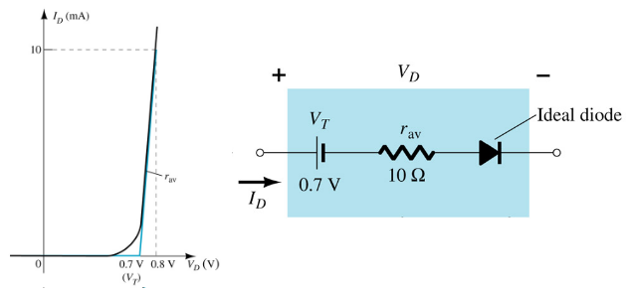
The Ideal Diode with Barrier Potential and Linear Forward Resistance
Diode Circuit Models
This model is the most accurate of the three. It includes a linear forward resistance that is calculated from the slope of the linear portion of the transconductance curve. However, this is usually not necessary since the R_{F} (forward resistance) value is pretty constant. For low-power germanium and silicon diodes the R_{F} value is usually in the 2 to 5 ohms range, while higher power diodes have a R_{F} value closer to 1 ohm.
+
V_{φ}
R_{F}

Slide 10
The Q Point
The operating point or Q point of the diode is the quiescent or no-signal condition. The Q point is obtained graphically and is really only needed when the applied voltage is very close to the diode’s barrier potential voltage. The example ³ below that is continued on the next slide, shows how the Q point is determined using the transconductance curve and the load line.
First the load line is found by substituting in different values of V_{φ} into the equation for I_{D} using the ideal diode with barrier potential model for the diode. With R_{S} at 1000 ohms the value of R_{F} wouldn’t have much impact on the results.
I_{D} = V_{A} – V _{φ}
R_{S}
Using V _{φ} values of 0 volts and 1.4 volts we obtain I_{D} values of 6 mA and 4.6 mA respectively. Next we will draw the line connecting these two points on the graph with the transconductance curve. This line is the load line.
R_{S} = 1000 Ω
I_{D}
+
V_{A}
= 6V
_
+
V_{φ}

Slide 11
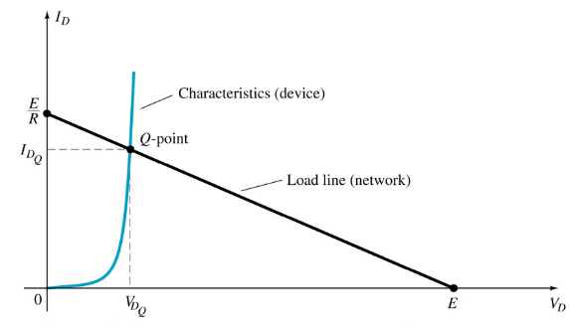
The Q Point

Slide 12
Dynamic Resistance
The dynamic resistance of the diode is mathematically determined as the inverse of the slope of the transconductance curve. Therefore, the equation for dynamic resistance is:
r_{F} = ηV_{T}
I_{D}
The dynamic resistance is used in determining the voltage drop across the diode in the situation where a voltage source is supplying a sinusoidal signal with a dc offset.
The ac component of the diode voltage is found using the following equation:
v_{F} = v_{ac} r_{F}
r_{F} + R_{S}
The voltage drop through the diode is a combination of the ac and dc components and is equal to:
V_{D} = V_{φ} + v_{F}

